Slide 1
Team Banana Muffin
Task 3 – IconPro
Ravish, Tejas, Meghraj

Slide 2
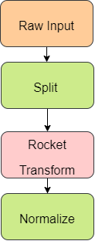
Architecture: Data Pre-processing
ROCKET - (RandOm Convolutional KErnel Transform)
Used for feature extraction from time series data
https://towardsdatascience.com/minirocket-fast-er-and-accurate-time-series-classification-cdacca2dcbfa

Slide 3
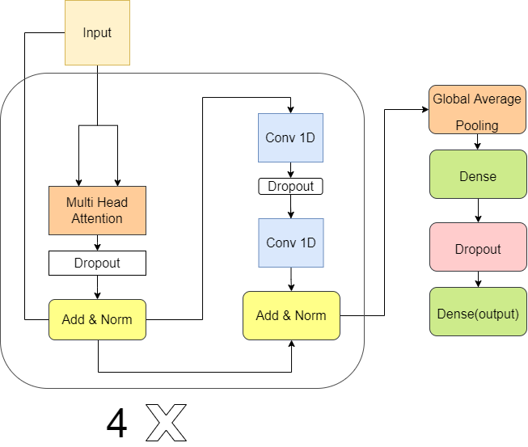
Architecture: Transformers
https://towardsdatascience.com/the-time-series-transformer-2a521a0efad3
https://towardsdatascience.com/how-to-make-a-pytorch-transformer-for-time-series-forecasting-69e073d4061e

Slide 4
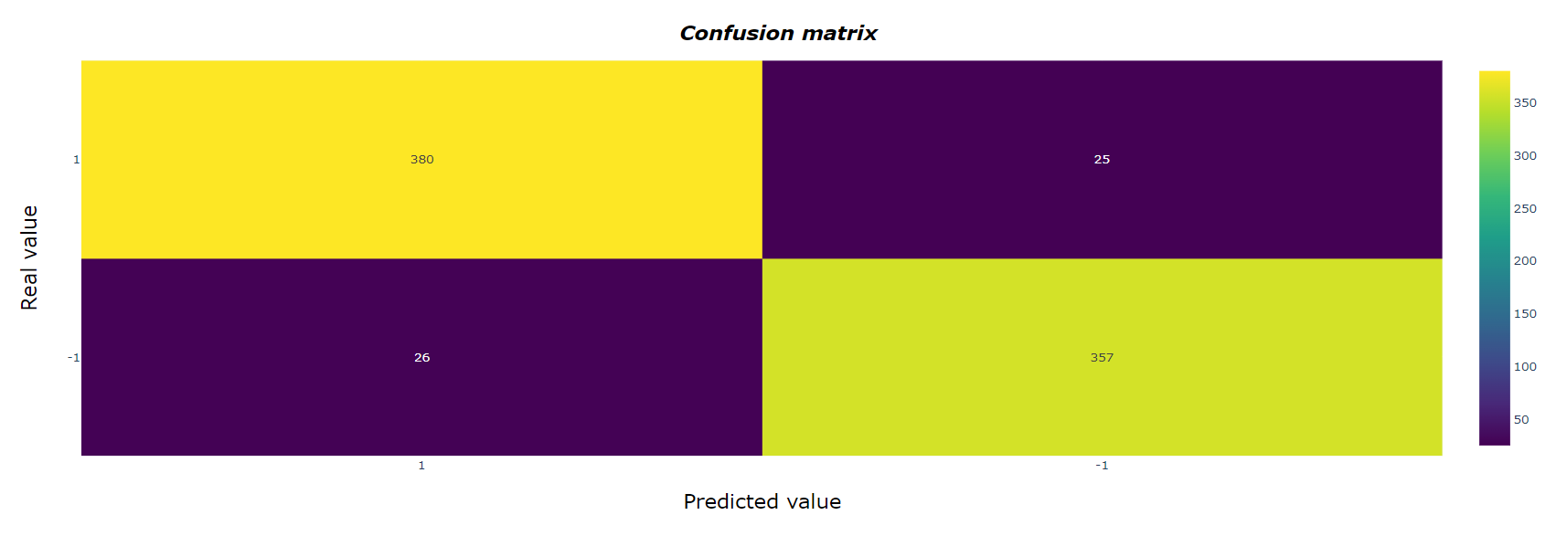
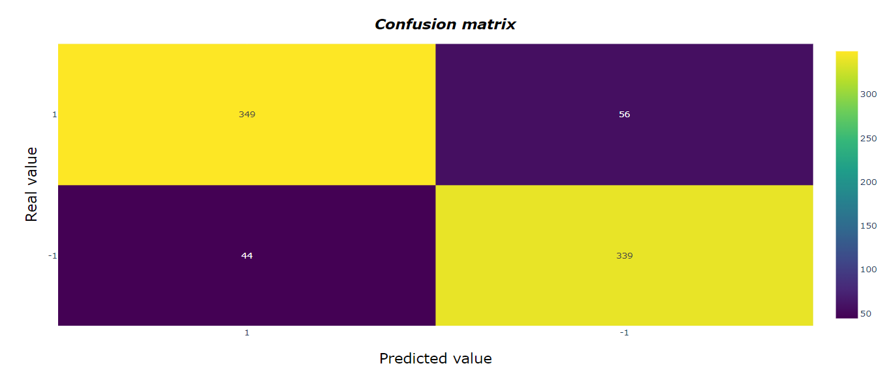
Confusion Matrix: Transformers vs LSTM
380
25
26
357
349
56
44
339

Slide 5
Balanced Accuracy:
Balanced accuracy of test set calculated from conf. matrix
= [(380/(380+26))+(357/(357+25))]/2
=(0.9359+0.9345)/2
=93.52%

Slide 6
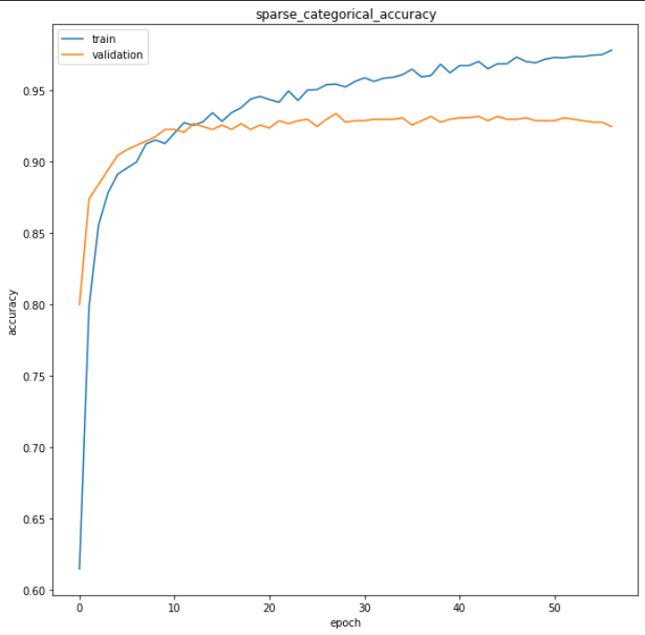
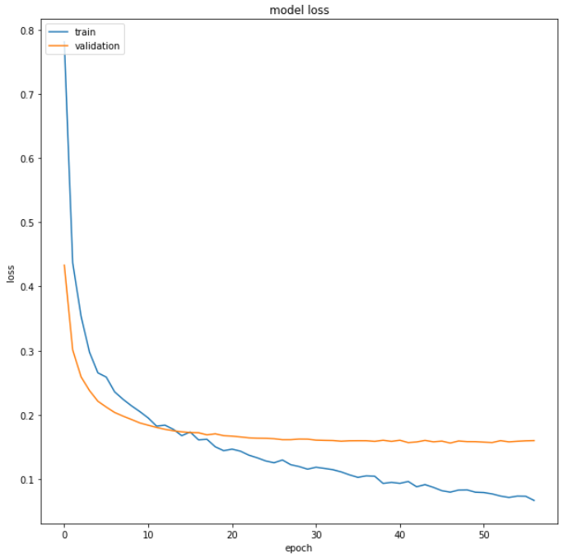
Accuracy: Transformers
Accuracy train = 0.97.4
Epoch - 47
Accuracy val = 93.4
Epoch - 28
Test Accuracy = 94.5

Slide 7
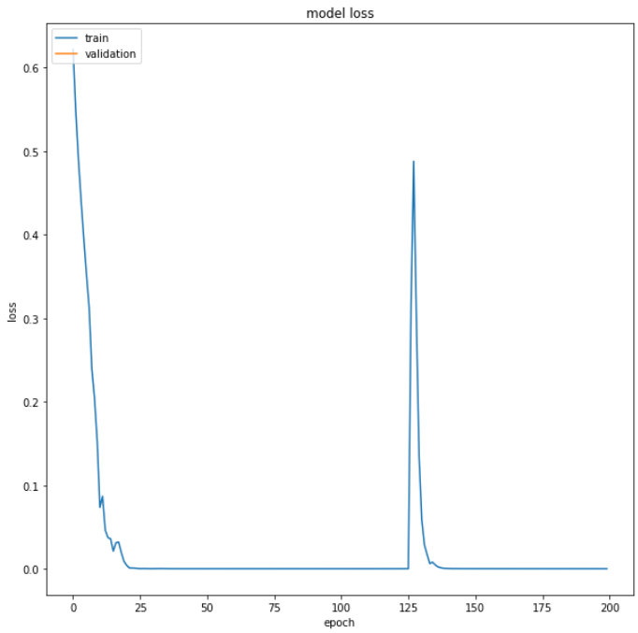
Accuracy: LSTM
Test Accuracy = 87.34

Slide 8
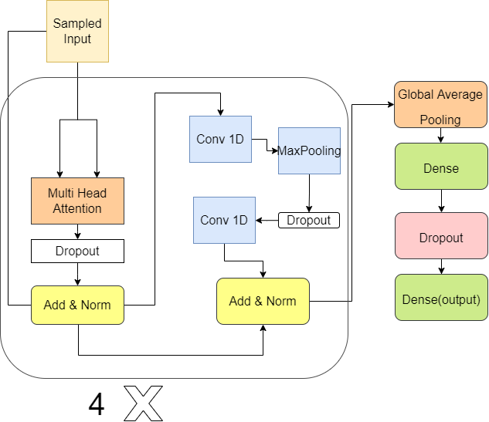
Architecture for Time Series Regression

